Slide 1
Day at the Capitol 2017
May 3rd, 2017
CaliforniaHealth+ Advocates

Slide 2
What is Day at the Capitol?
Day at the Capitol (DAC) is an annual event that welcomes clinicians, directors, patients and health center advocates to Sacramento to engage with legislators and legislative staff about budget and legislative priorities impacting community health centers.
CaliforniaHealth+ Advocates, brings new elements to this exciting day in an effort to show our statewide strength! CaliforniaHealth+ Advocates is a CPCA affiliated organization created to advance the mission of community health centers. The new organization provides health centers more flexibility and capacity to advocate, above and beyond what is allowed by CPCA as a charity. All of our state level advocacy work will now be conducted by CaliforniaHealth+ Advocates.

Slide 3
Agenda
Day at the Capitol Schedule and Logistics
Coffee with Clinics Health Fair
DAC Mobile App
Legislative Landscape
Legislative Priorities & Meeting Materials
Effective Legislative Visits
Q&A

Slide 4
DAC Morning Program
8:00 – 9:30 AM BREAKFAST, WELCOME & GENERAL BRIEFING
LOCATION Sacramento Convention Center – Room 203/204
        8:00 - 8:30 AM Pick-up Name Badge & Materials
          You must have an Advocates name badge to participate in the lunch program – registration required!
        8:30 - 9:00 AM Welcome & General Briefing
        9:00 - 9:30 AM Legislative Visit Coordination
9:30 - 9:45 AM JOINT WALK TO THE CAPITOL GROUNDS
Depart Sacramento Convention Center
9:45 - 10:00 AM GROUP PHOTO
LOCATION West Steps of the Capitol
10:00 – 11:00 AM CELEBRATING THE ACA: A Highlight of Our Success
COMMUNITY HEALTH CENTER CHAMPION AWARDS
Legislative and Guest Speakers
LOCATION West Steps of the Capitol

Slide 5
DAC Afternoon Program
10:30 - 12:00 PM LEGISLATIVE VISITS
COFFEE WITH CLINICS & HEALTH FAIR (11:00 AM - 2:00 PM)
12:00 – 1:30 PM MARKETPLACE LUNCH
LOCATION West Steps of the Capitol
          12:30 – 1:00 PM Keynote Speaker
1:30 – 5:00 PM LEGISLATIVE VISITS
2:00 – 5:00 PM LOUNGE ON THE PATIO
LOCATION Cafeteria 15L (Patio) 1116 15th Street
5:00 – 7:00 PM RECEPTION
LOCATION Cafeteria 15L (Patio) 1116 15th Street

Slide 6
Capitol Steps and Lunch Program
Celebrating the ACA: Highlights of Our Success
Capitol Step Program featuring:
  Assemblywomen Lorena Gonzalez-Fletcher (AD 80)
  Assemblymember Jim Wood (AD 2)
  State Senator Richard Pan* (SD 6)
  State Senator Holly Mitchell* (SD 30)
Marketplace Lunch Keynote Speaker
  California’s Attorney General, Xavier Becerra
  You must have an Advocates name badge to participate in the lunch program
    Which means registration is required!
*Denotes 2017 Community Health Center Champion Award

Slide 7
Coffee with Clinics Health Fair
Ampla Health
California School-Based Health Alliance
Cares Community Health
Clinica Sierra Vista
Community Medical Centers
Golden Valley Health Centers
LifeLong Medical Care
Marin Community Clinics
Neighborhood Healthcare
Sonoma Valley Community Health Center
Tri-City Health Center
The Children’s Clinic
Venice Family Clinic
West County Health Centers

Slide 8

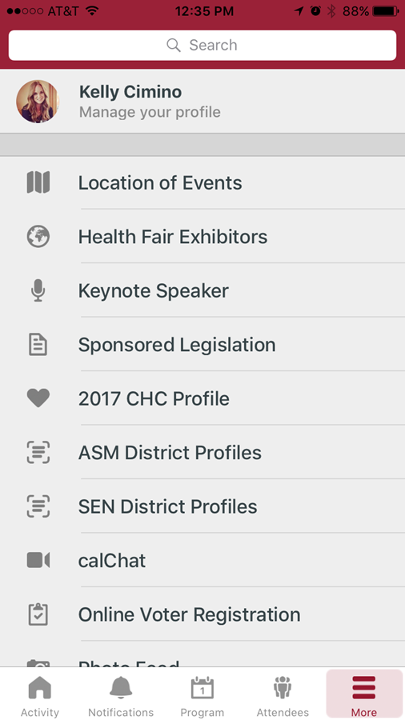
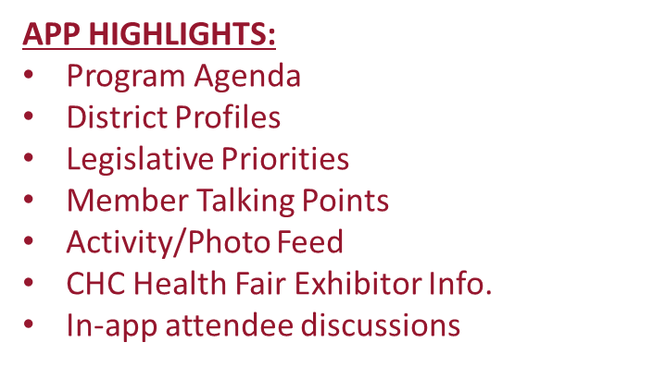

DAC Mobile App

Slide 9
Legislative Landscape
Legislative Process
  4/19: Senate Health Hearing - SB 323 (Mitchell) and SB 456 (Pan)
  4/28: Last day for policy committees to hear and report to fiscal committees fiscal bills
  Next Stop: Appropriations
State Budget
  Ongoing Hearings
    Senate Subcommittee 3 on Health and Human Services
    Assembly Subcommittee 1 on Health and Human Services
  Next Stop: May Revise

Slide 10
Legislative Priorities
Behavioral Health Access to Care: Senate Bill 323 (Mitchell) will help our state’s behavioral health delivery system by leveraging the role of community health centers. The bill clarifies how community health centers can contract and be paid outside of the traditional PPS rate for the delivery of Drug Medi-Cal (DMC) and Specialty Mental Health (SMH) services.
Care Coordination: Senate Bill 456 (Pan) will improve the health of California’s most vulnerable people by allowing community health centers to be reimbursed for services that promote continuity of care and wellness in ways not covered by the current PPS rate. These services are referred to as “services that follow the patient” and may include care coordination, case management, health and wellness initiatives, comprehensive transitional care, individual and family support services, and more.

Slide 11
Budget Priorities
340B: 340B is a federal drug discount program that was designed to support the mission of safety-net providers like community health centers with prescription drug discounts that allow the provider to stretch scarce federal resources. DHCS proposes changing the program in a way that will harm community health center’s ability to leverage program savings to better serve uninsured and underserved, greatly reducing access to care.
Workforce: The Governor’s proposed budget eliminates the $100 million investment made in last year’s budget to help combat the primary care workforce crisis in California. Without this investment, California’s primary care residency programs will be destabilized, and if Congress doesn’t further fund the program, many programs will be forced to close.

Slide 12
Budget Priorities
Newly Qualified Immigrants: Immigrant adults who have been in the country for less than five years are barred from receiving federal Medicaid benefits, but are eligible for state-funded Medi-Cal benefits if they meet income eligibility requirements. The Governor’s proposed budget plans to transition these patients to Covered California. Patient groups have opposed this proposal in the past because the Medi-Cal program is better suited to serve the needs of low-income immigrants due to Medi-Cal provider’s focus on culturally competent care that puts a premium on understanding the patients’ language, culture, and individual needs.
Behavioral Health Access to Care: The proposed budget delays the implementation of AB1863 (Wood), which expanded access to behavioral health services in community health centers, until at least July 2018. This delay would force high need patients to wait even longer for behavioral health services and force health centers to terminate Marriage and Family Therapists who they hired based on the law’s January 2017 start date.

Slide 13
Federal Priorities
Health Care: The national healthcare debate is threatening the incredible health care advances in California. The ACA and Medicaid are successful in California and we cannot lose the gains we have made. We must continue to invest in community health centers, the heart of the Medicaid program, and invest in the workforce initiatives that ensure we can meet our patient’s needs.
Planned Parenthood: Planned Parenthood is an essential provider and community health centers cannot absorb their more than 850,000 patients if they are restricted from receiving Medicaid resources.

Slide 14
Protecting Our Patients: Immigrants
Presidential executive orders, signed and leaked, and harsh rhetoric aimed at immigrants are having a detrimental impact on immigrants in California.
Impact on Patients: Fearing deportation, patients of community health centers are cancelling appointments and dis-enrolling in important public health programs like Medicaid.
Impact on Workforce: Absenteeism among health center staff is increasing. The workforce crisis has been further exacerbated by the restrictive federal immigration policies.

Slide 15
Key Members of the Legislature
Sponsor Bill Advocacy
Hernandez, Sen Health Chair
Lara, Sen Appr Chair
Wood, Asm Health Chair
Gonzalez-Fletcher, Asm Appr Chair
de Leon, Pro Temp
Rendon, Speaker
Budget Advocacy
Mitchell, Sen Chair Budget & Fiscal Review
Ting, Asm Chair Budget
Pan, Sen Chair Sub3
Arambula, Asm Chair Sub1
de Leon, Pro Tem
Rendon, Speaker

Slide 16
Legislative Visit Coordination
Each visit should have a “Team Leader” a consortia representative, if applicable.
  Advocates will provide one leave behind folder per district, which is given to the consortia who schedules the visit.
  There will be an opportunity immediately following the morning program to break into groups, discuss materials and delegate team leaders and/or speakers for each meeting.
Advocates Member Folders will include:
  Advocates Legislative Priorities and Talking Points and an Advocates State Profile

Slide 17
Effective Legislative Visits
Plan to meet in front of your representatives office 10 minutes prior to your meeting time.
  Remember you have limited time with the member/staff
  Keep it local and personal
  Speak clearly and concisely
  NO election/fundraiser discussions
  Above all…be patient and flexible

Slide 18
Questions
Legislative Priorities
  General
    Beth Malinowski / beth@healthplusadvocates.org
    Victor Christy / victor@healthplusadvocates.org
  Immigration
    Liz Oseguera / liz@healthplusadvocates.org
  Workforce
    Beth Malinowski / beth@healthplusadvocates.org
Materials & Logistics
    Kelley Aldrich / kelley@healthplusadvocates.org
    Glenna Davido / gdavido@cpca.org

