Slide 1
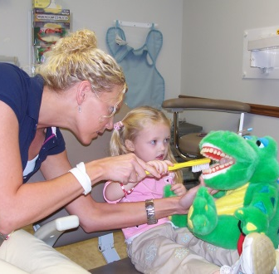
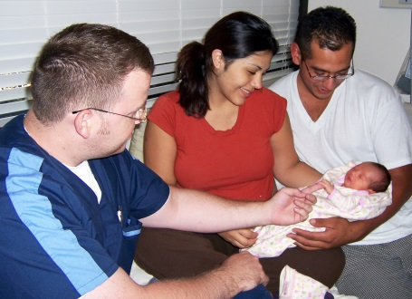
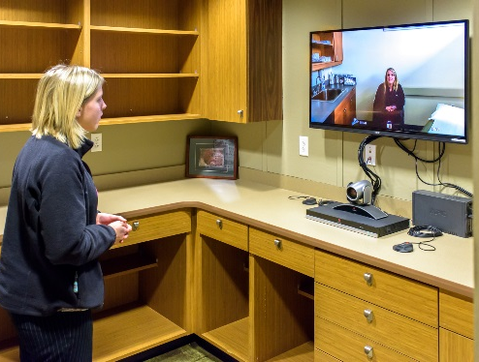
Bureau of Primary Health Care All-Programs Webcast September 27, 2017

Slide 2
Agenda
Welcome
Month in Review
Compliance Manual
BHW Workforce Connector
Q&A

Slide 3
Month In Review
National Health Center Week
UDS Data Release
Quality Improvement Awards
NACHC Community Health Institute
UDS Manual Release
Compliance Manual Implementation

Slide 4
AIMS Awards Rollout – September 14
More than $200 million
to nearly 1,200 Heath Centers
More than $3 million
to 13 rural health organizations
Technical Assistance:
https://bphc.hrsa.gov/programopportunities/fundingopportunities/supplement/index.html

Slide 5
Looking Ahead: Fiscal Year 2018
Fiscal Year 2018 Continuing Resolution
extended through December 8, 2017
President’s Budget Request =
$5.1 billion
Proposes to extend current mandatory funding at $3.6 billion annually for FY 2018 and FY 2019

Slide 6
Compliance Manual Implementation
Angela Powell Ernia Hughes
Director, Office of Southern Health Services Director, Office of Northern Health Services
Bureau of Primary Health Care Bureau of Primary Health Care
Health Resources and Services Administration Health Resources and Services Administration

Slide 7
CM Implementation Details
Compliance Manual effective date: August 28, 2017
Streamlined resource to assist in understanding and demonstrating compliance with Health Center Program and Federal Tort Claims Act deeming
Applies to all compliance determinations

Slide 8
CM Implementation Areas of Inquiry
Site Visits
Service Area Competition (SAC) Reviews
Progressive Action Conditions
FTCA Redeeming

Slide 9
OSV Alignment with CM
Compliance determinations are based on the CM
Continue use of current Site Visit Guide
New Site Visit Protocol aligned with CM effective January 2018
OSV reports
HSOs Staff ensuring noncompliance findings are consistent with CM
Action steps refer to CM “Demonstrating Compliance” elements
No longer include prescriptive narrative

Slide 10
Compliance Assessment
HRSA Compliance Determination
Condition(s) on Award
Technical Assistance
Submission of Compliance “Data”
(SAC application/ OSV/Response to Condition)

Slide 11
CY 18 FTCA Deeming
Alignment of FTCA redeeming and H80 Program credentialing/privileging (CP) and QI/QA compliance requirements (May 2017 PAL 2017-03)
Essential that Health Centers address QI/QA and/or CP conditions to satisfy CY 18 FTCA redeeming requirements
HSOs committed to providing needed technical assistance

Slide 12
Streamline Federal Tort Claims Act (FTCA) Deeming
Service Area Competition and Operational Site Visit
FTCA Application + Operational Site Visit Supplement
FTCA Deeming
Quality Improvement/Quality Assurance
Risk Management
Claims Management
Credentialing and Privileging

Slide 13
How to access
The Compliance Manual
Go to: bphc.hrsa.gov
Click on: Health Center Program Requirements
Click on: Health Center Program Compliance Manual
Related FTCA Deeming PAL 2017-03
Go to: bphc.hrsa.gov
Click on: Federal Tort Claims Act (Located on top bar)
Under News & Announcements click on: CY 2018 Requirements for Federal Tort Claims Act (FTCA) Coverage for Health Centers

Slide 14
Where to go for assistance
Frequently Asked Questions (FAQs)
Go to: bphc.hrsa.gov
Click on: Health Center Program Requirements
Click on: Health Center Program Compliance Manual
Click on: PDF under Frequently Asked Questions
General Questions
Helpline: 1-877-974-BPHC (2742) from 8:30 am - 5:30 pm ET
Grant/Look Alike-specific Questions
HSOs Project Officer

Slide 15
Health Workforce Connector
Bureau of Health Workforce
Health Resources and Services Administration

Slide 16
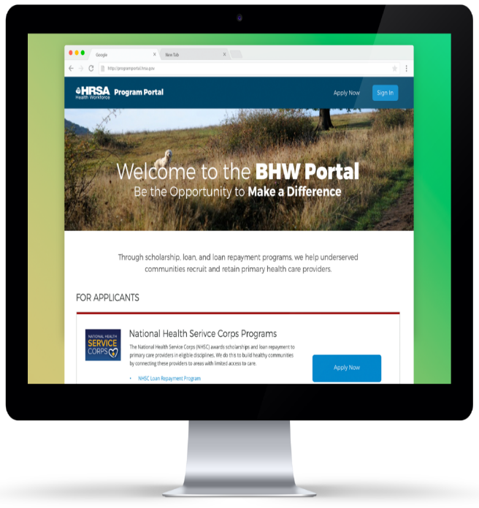
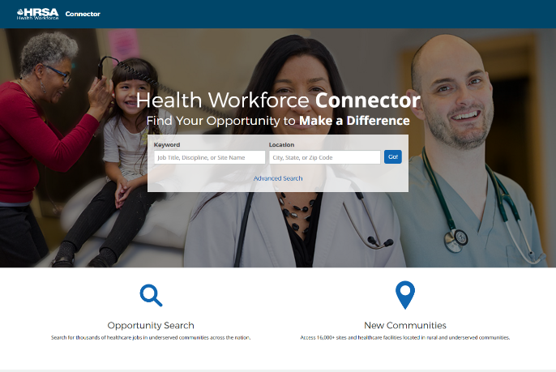
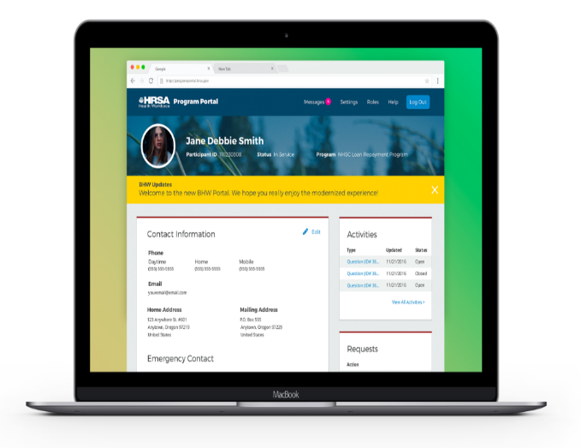
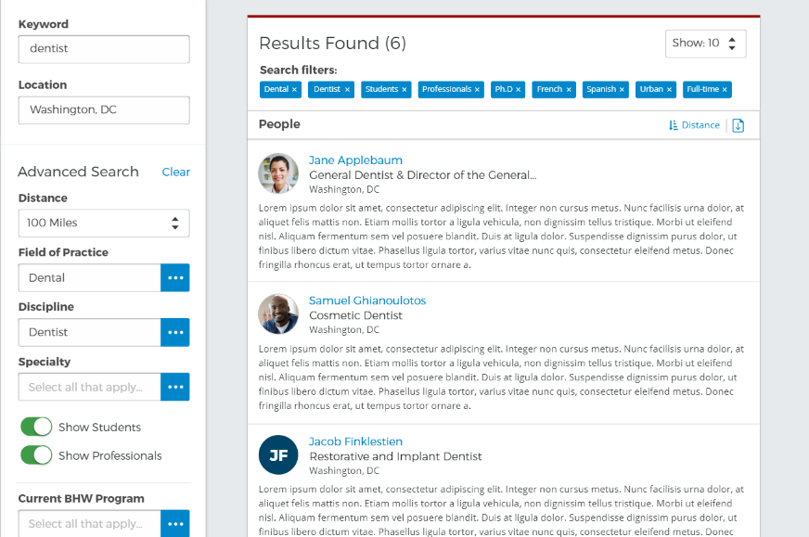
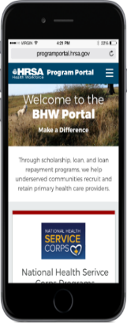
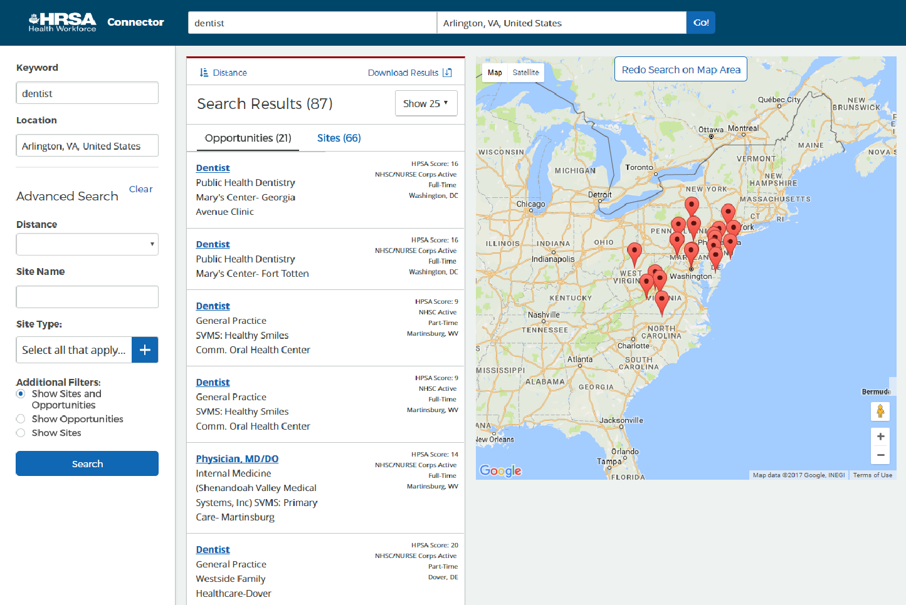
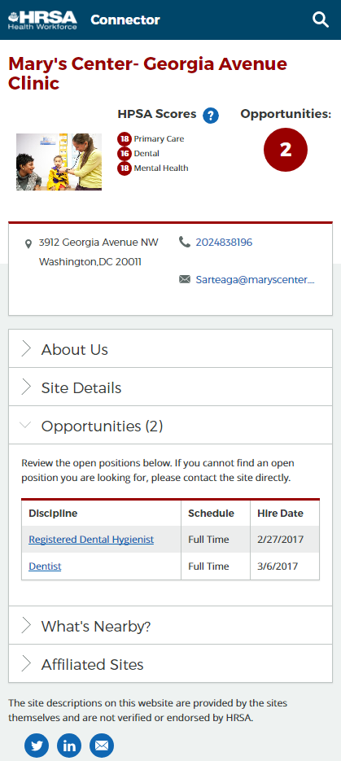
Health Workforce Connector
Where Health Care Professionals Connect with Sites!
View more than 21,000 NHSC and NURSE Corps-approved sites with over 5,000 job vacancies.
Search jobs by:
Field of Practice
Discipline
Specialty
HPSA Score
Site Name
City, state, or Zip Code
Sites with Open Positions
BHW’s Health Workforce Connector makes it easier for health care providers to connect with sites.

Slide 17
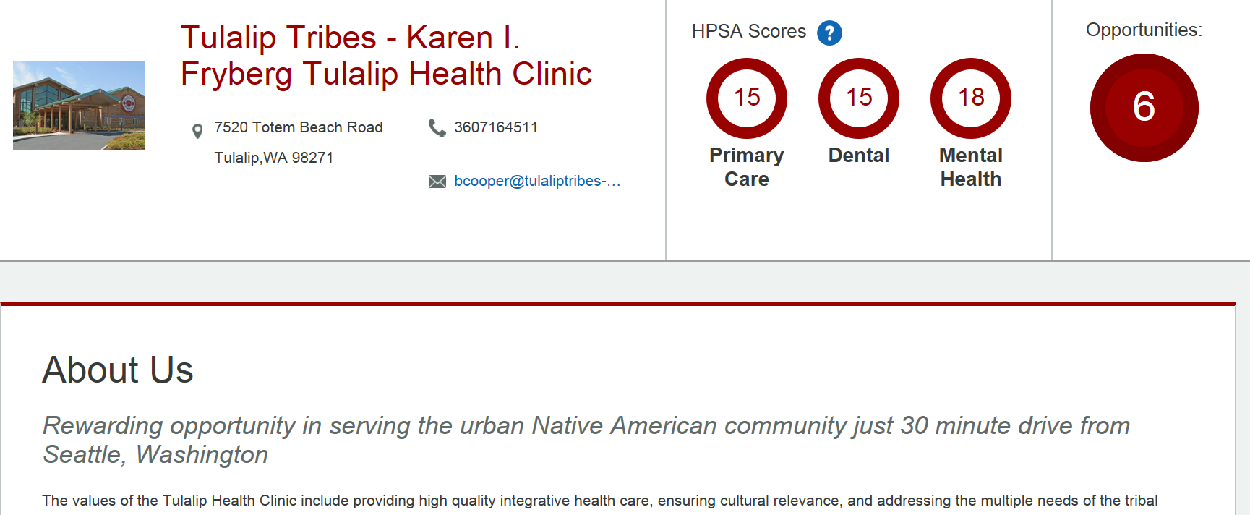
Connector Site Profile
Recruit Qualified Clinicians:
Free online recruitment resource where all NHSC and NURSE Corps-approved sites can post medical, dental, and mental and behavioral health job vacancies.
Create a site profile highlighting:
Job Opportunities
Services Provided
Employee Benefits
Site Characteristics
Local Community (schools, attractions, etc.)
Photos
Relevant Links & Websites

Slide 18
Health Center Snapshot
Job Types
21,757 Sites available for search on the Connector
9,491 CHCs and Look-alikes on the Connector
Discipline:
Dentist
Registered Dental Hygienist
Licensed Clinical Social Worker
Nurse Practitioner
Marriage and Family Therapist
Licensed Professional Counselor
Physician, MD/DO
Physician Assistant
Psychiatric Nurse Specialist
Health Service Psychologist
Certified Nurse/ Midwife
Registered Nurse
Clinical Nurse Specialist
Nurse Anesthetist
Nurse Faculty
Nurse/Midwife
12,784 Sites with Complete Profiles
5,967 CHCs and Look-alikes have complete profiles
2,343 Sites with Open Positions
1,490 CHCs and Look-alikes have open positions
Specialties:
General Practice
Pediatrics
Geriatrics
Psychiatry
Adult
Family Practice
Women's Health
OB/GYN
Family Practice w/ OB
Internal Medicine
5,113 Open Positions
3,231 open positions at CHCs and Look-alikes

Slide 19
How to Update your Profile and Post Jobs

Slide 20
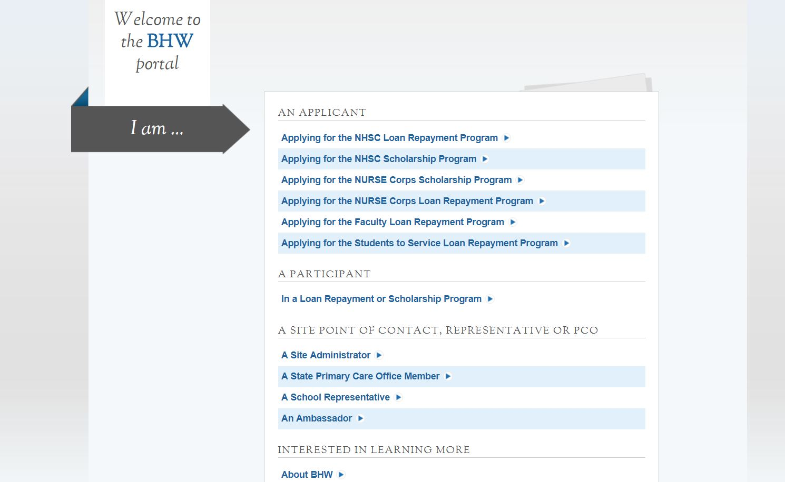
Programportal.hrsa.gov
Site Administrators log in to the BHW Customer Service Portal to manage everything related to
their Site.

Slide 21
Manage Site Profile
Once logged in, click on Manage Site Profile to make updates that will be visible on the Connector.
The Self-Service Dashboard allows Site POCs to manage everything related to your sites, including Site Visits, POC contact info, and notifications.

Slide 22
Site Headline and Description
The Site Headline will display in the ‘About Us’ section of your site profile.
The Description allows you to give additional details about your site to aid in recruiting.

Slide 23
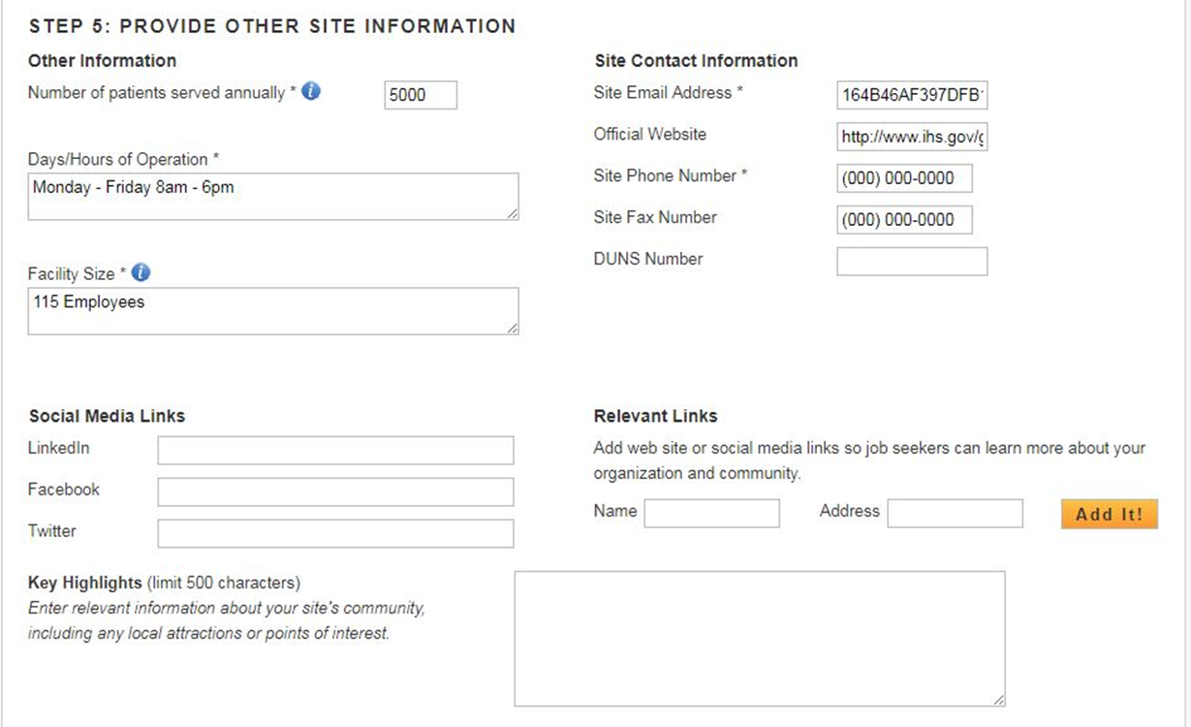
Site Details
Fill in as many details as you can to help the job seeker learn about your site. The starred fields must be complete in order to save your profile and post jobs.

Slide 24
Manage Current Job Openings
Go back to the Self-Service page and click on Manage Current Job Openings to post or edit your jobs.

Slide 25
Position Details
Select your NHSC and NURSE Corps- approved Discipline and Specialty.

Slide 26
Additional Position Details
Determine when you want your job to expire.
After filling out the information you want to be visible to job seekers, click on the Create button to save.

Slide 27
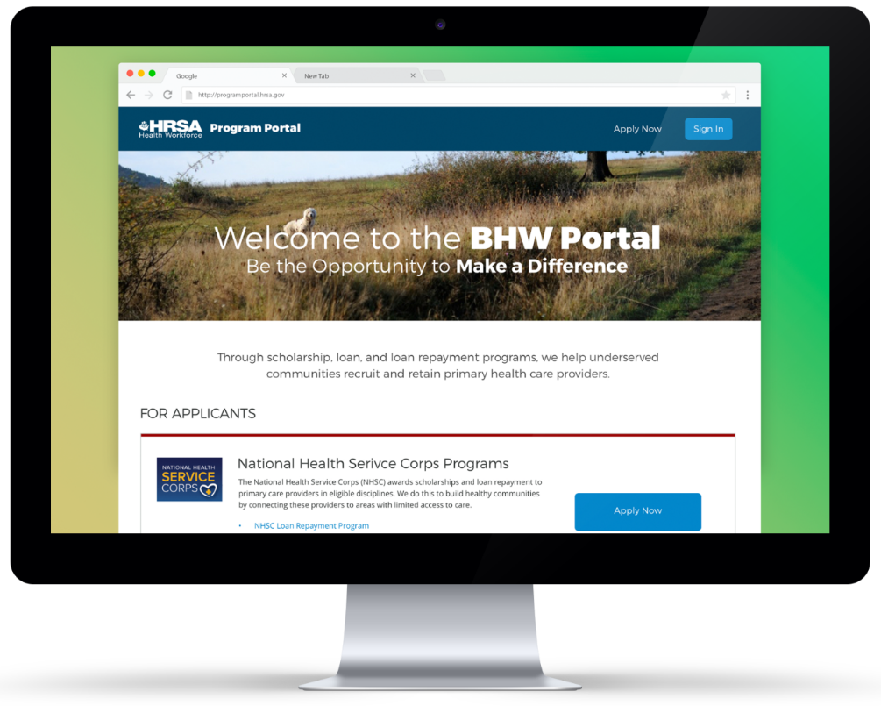
Connector.hrsa.gov
Your Site Profile and Jobs will now be searchable on the Connector!

Slide 28
What’s coming next?
User Profile
Job seekers will have the ability to create their own profiles, detailing education and experience.
Profile Search (Site Admin only)
Verified site administrators can search a database of potential candidates to fill open positions.
System Redesign
Newly designed dashboard and navigation. Streamlined UX, modernized look and feel.
Site Dashboard & Profile
Newly designed site dashboard and a streamlined experience for updating site profiles.
Opportunity Management
Ability to create, edit, repost, and close jobs. Ability to post a single job across multiple sites.
Custom Notifications
Custom email notifications for job expirations.
Site POC Management
Ability to add new POCs and assign roles, program affiliations, and site affiliations to existing POCs.
Security & General Functionality
Ability to login, create account, reset password, and update account settings.
Data Migration
Data migration of site profiles and opportunities to the new data model.

Slide 29
Collaborate With Us
Next Steps
Check out your site profile on the Connector at https://connector.hrsa.gov
Update your profile and Post jobs from the Customer Service Portal at https://programportal.hrsa.gov
Need Help with your Site Profile or Posting Jobs?
Please contact: Customer Care Center at 1-800-221-9393
(TTY: 1-877-897-9910)

Slide 30
Q&A
Thank you for participating!
To ask a question, please use the “submit a question” button toward
the top of the window under the HRSA logo.
You can also dial 1-888-790-1897
Use the passcode: “Webcast”
Please then press *1 to enter the question queue.
Please mute your computer speakers when asking a question.
Please remember to complete today’s survey.

