Slide 1
Open Enrollment and the Federal Landscape
Jessica Kendall
Director of State Partnerships
Families USA

Slide 2
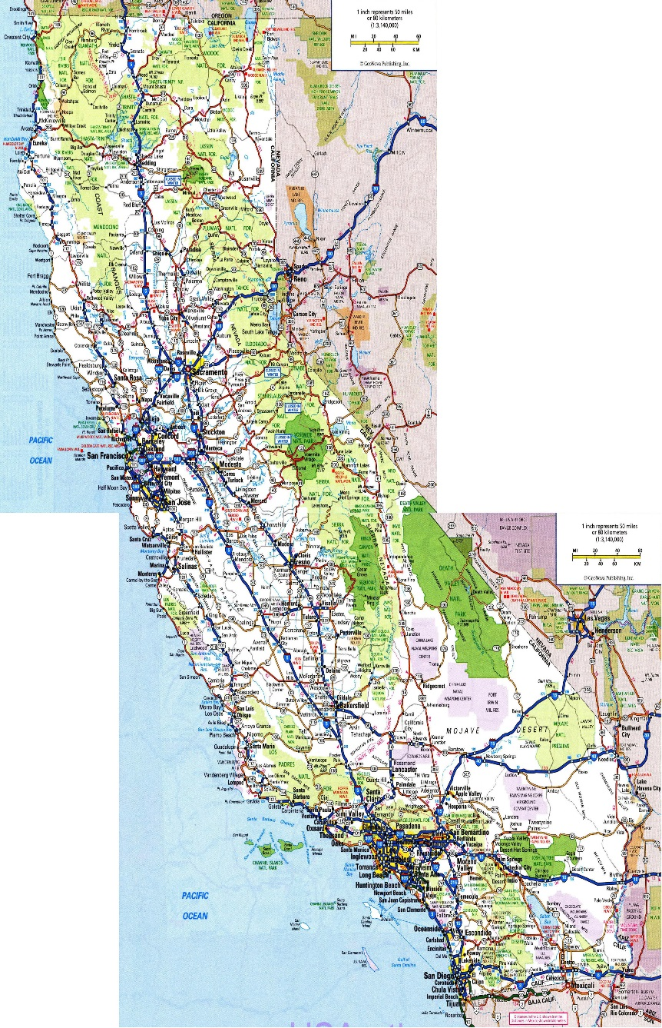
Today
Who we are
What we know
What we don’t know
What we are doing
What you can do

Slide 3
Families USA Priority: Protect Our Care
Enrollment Assister Network
Prescription Drug Pricing
Community Health Workers
Oral Health
Coverage for Justice Involved populations
Network Adequacy

Slide 4
“There are known knowns; there are things we know we know. We also know there are known unknowns; that is to say we know there are some things we do not know. But there are also unknown unknowns – the ones we don't know we don't know.” –Donald Rumsfeld

Slide 5
What We Know

Slide 6
What Can We Plan For?
Open enrollment
After open enrollment
Next navigator cycle

Slide 7
What Do We Else Know?
Benefits of the ACA
Impact of repeal without replace
Intent from policymakers to change health coverage

Slide 8
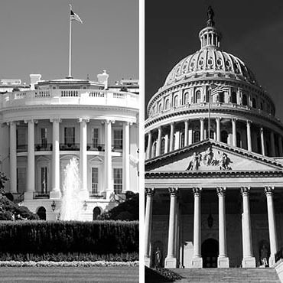
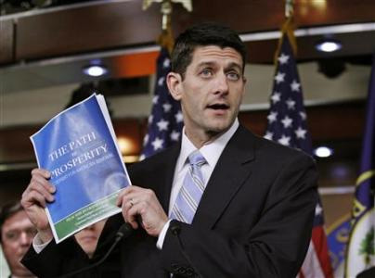
New Leaders’ Intentions

Slide 9
NEW Report from the Urban Institute
Modeled after partial repeal through reconciliation
Focuses largely on effect in 2019

Slide 10
What Don’t We Know?
What is the exact timing the process?
Will repeal and replace happen at the same time?
What will be included in a replacement plan?
When will people be affected?
What is the immediate effect on the market?
And the list goes on…..

Slide 11
Families USA
Federal Landscape: What Are We Doing?

Slide 12
Protect Our Care: Families USA’s Plans
National partnerships
Federal lobbying
Data analytics and policy analysis
Communications and story banking
State, local, and individual engagement

Slide 13
National Partnerships

Slide 14
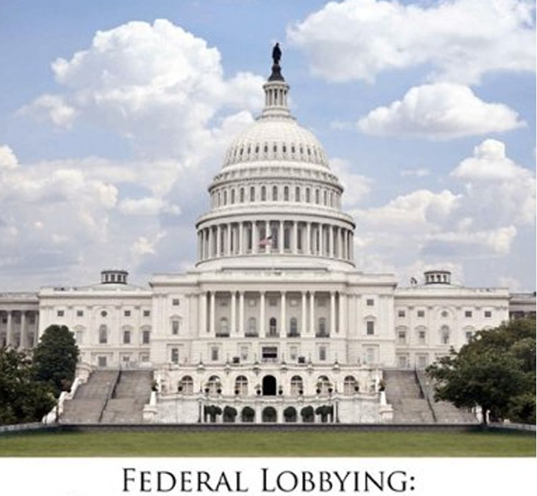
Federal Lobbying

Slide 15
Moving Your Member of Congress
What matters to them?

Slide 16
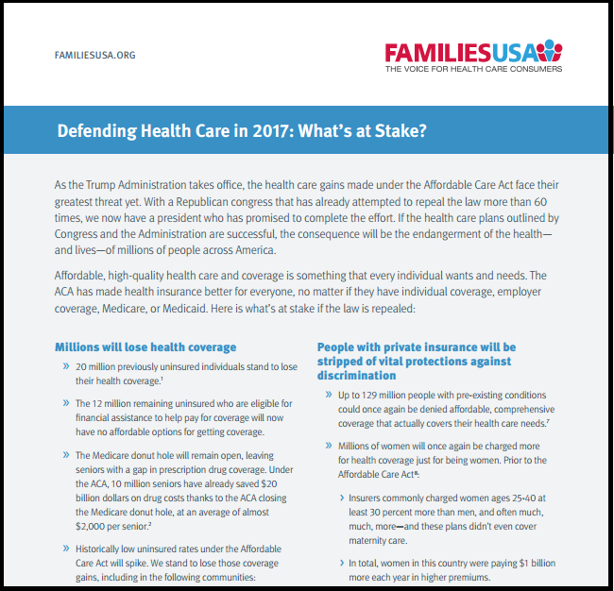
What’s At Stake?

Slide 17
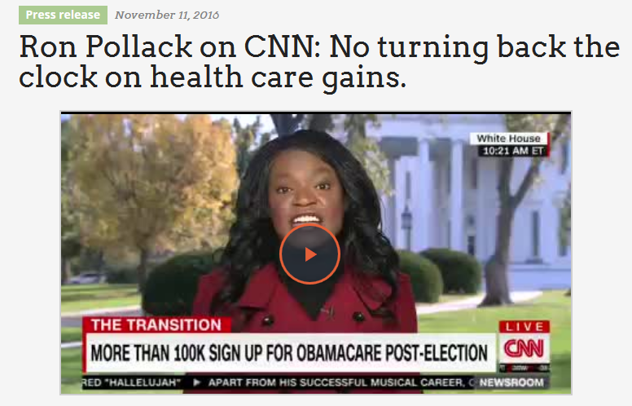
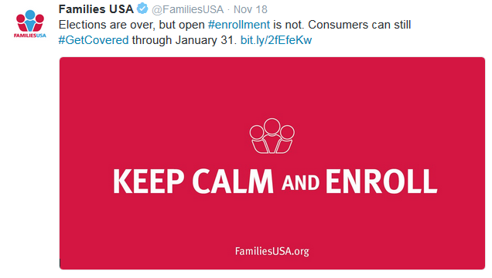
Communications

Slide 18
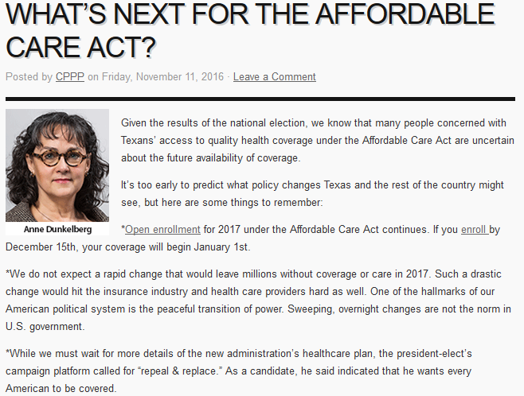
State-Based Health Care Defense Campaigns

Slide 19
What else can we do?

Slide 20
Families USA Week of Action Resources

Slide 21
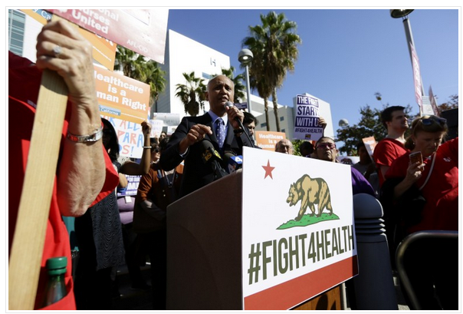
Week of Action to Protect our Care

Slide 22
Keep America Covered Petition
http://familiesusa.org/protect-americas-health-coverage

Slide 23
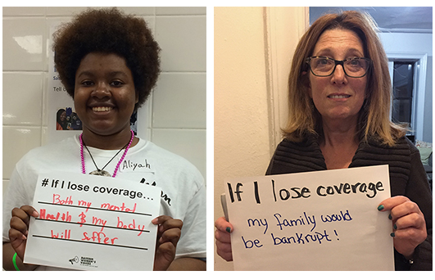
Tapping Into Other Efforts

Slide 24
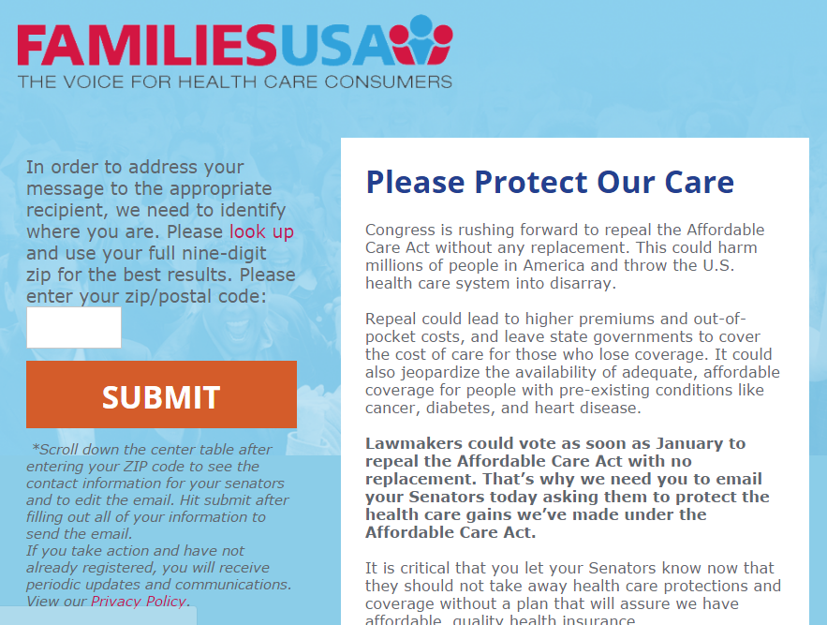
Contacting Members of Congress

Slide 25
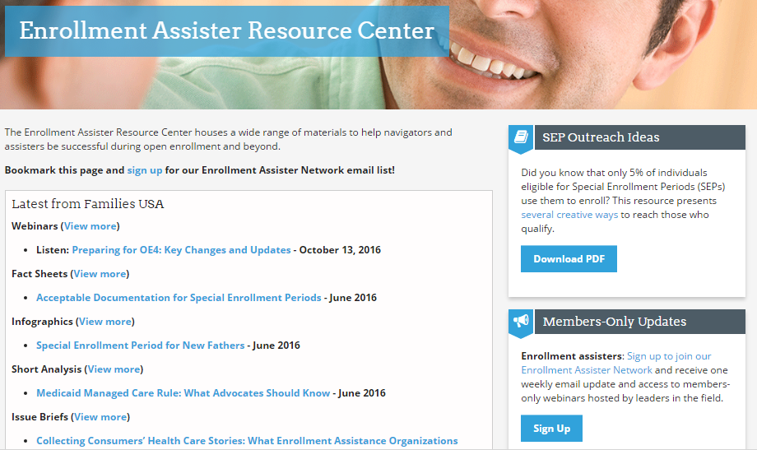
Enrollment Assister Resource Center

Slide 26
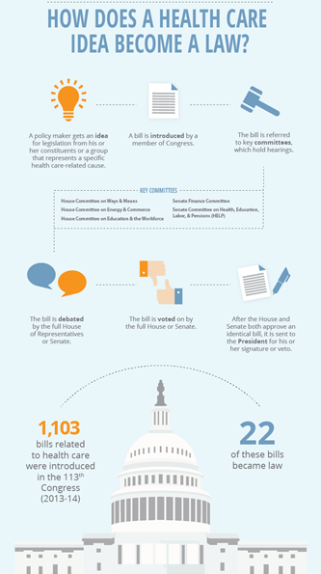
Public Policy Toolkit
http://familiesusa.org/Assisters-Toolkit

Slide 27
Story Bank Toolkit for Assisters
http://familiesusa.org/product/collecting-consumers-health-care-stories-what-enrollment-assistance-organizations-need-know

Slide 28
Join us at Health Action
#HA2017 Theme:
New President, New Congress, New Agenda
for Health Care Advocacy
Early Bird registration ends December 16!
www.familiesusa.org

Slide 29
Questions?
Contact us:
assisters@familiesusa.org
(202) 628-3030
Visit the Enrollment Assistance Resource Center:
http://familiesusa.org/navigators-and-assisters-resource-center/enrollment-information.html
Sign up for the Enrollment Assister Newsletter:
http://fusa.convio.net/site/R?i=GXX2tYWoaJhUPhjrCctNow
1201 New York Avenue, NW, Suite 1100
Washington, DC 20005
main 202-628-3030 / fax 202-347-2417
Notes:
HB

