Slide 1


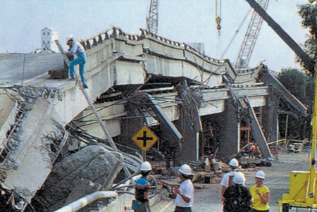
Road to CMS Emergency Preparedness Requirements: Hands on Hva & EOP
Connect Consulting Services, Inc.
February 22, 2017

Slide 2
Training Agenda
HCPSC Welcome and Ice Breaker
How to Conduct an Hazard Vulnerability Analysis (HVA)
  How to use the HVA information to create your Emergency Operations Plan (EOP)
Hands on HVA Technical Assistance Session
Key elements of a robust Emergency Operations Plan
  HRSA Program Information Notices 2007- 015 and FTCA Policy Manual
  CMS Emergency Preparedness Requirements EOP Checklist
EOP Technical Assistance
Debrief and Next Steps

Slide 3
Connect Consulting Services, Inc.
Project Team Members
Nora O’Brien, MPA, CEM- CEO- CPCA staffer from 2001-2009, launched CCS in 2009 to assist clients with developing emergency management plans, training and drills and exercises
Cathy Larsen, MA, Director of Planning and Development- former Executive Director of Southern Trinity Health Center and years of healthcare emergency management planning
Paul Small, BA, EM, Emergency Management Planner- former U.S. Air Force Emergency Manager who has been stationed throughout the world planning and conducting exercises
Norma Springsteen, BA, Director of Operations- years of coordinating projects for the Yolo County Department of Public Health and CAPG

Slide 4
CMS Emergency Prep Requirements
In 2016, the Centers for Medicare and Medicaid issued final Conditions of Participation (CoP) for 17 types of Medicaid and Medicare providers @ emergency management- FQHCs, RHCs, CMHA, IHS, hospice, LTCs, etc. by November 15, 2017
Requirements will include:
  Conduct Risk Assessment and Planning
  Develop Policies and Procedures
  Create Communication Plans
  Training and Plan Testing
  CMS Emergency Preparedness Rule Overview

Slide 5
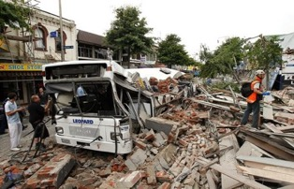
HCPSC CMS Project Overview
Offering a Health Center CMS Compliance Self- Assessment Tool- January
Hosting monthly technical assistance calls to HCPSC members get to CMS Compliance – January to June
Conduct an emergency management training geared to supporting HCPSC members seeking to meet the CMS emergency preparedness requirements- June 27

Slide 6
2017 CMS Technical Assistance Schedule
February 28, 11am- Emergency Plan policies and procedures development and update to meet the CMS requirements
March 28, 11am- Communication plan development and update
April 25, 11am- Emergency training process & documentation
May 30, 11am- Preparing for tabletop and/or functional exercises
June 13, 11am- Developing a full-scale exercise to test your emergency plans
June 27- 9am-3pm- An in-person training on how to conduct a full-scale drill training with an exercise at a member health center

Slide 7
Risk Assessment
CMS Requirement: All FQHCs must identify risks and vulnerabilities via a Hazard Vulnerability Analysis process annually
A Hazard Vulnerability Analysis (HVA) created by Kaiser HVA Tool pinpoints:
  Hazards and/or vulnerabilities that need your attention;
  Actions that might be taken to reduce the impact of those hazards;
  What resources are likely to be needed to mitigate and prepare for hazards.
Best practice tips: Conduct a HVA for each CHC site annually and ask neighboring healthcare provider for their HVA - same area, same hazards!

Slide 8
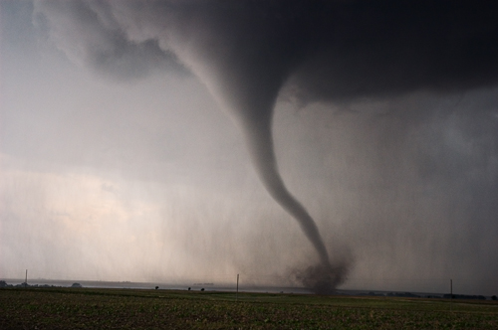
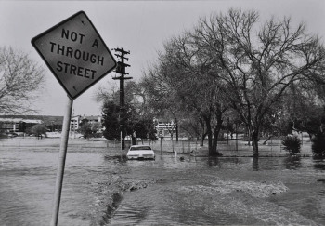

Hazard Vulnerability Analysis (HVA)
What????
Hazard Vulnerability Analysis (HVA):
  Process to help Clinics evaluate their vulnerability to specific hazards;
  Puts each hazard in perspective by using categories:
    Probability of the Hazard Occurring;
    Impact of the Hazard;
      Human Impact;
      Property Impact;
      Business Impact.
    Preparedness of your organization;
    Ability to Response to the Hazard:
      Internal Response;
      External Response.

Slide 9

Hazard Vulnerability Analysis (HVA) purpose
Purpose of HVA is to Make Risk-Based Choices:
  Address your Vulnerabilities;
  Mitigate Hazards;
  Respond to Events;
  Recover from Events;
  Create an Emergency Operations and Business Continuity Plans to address greatest Risks.

Slide 10
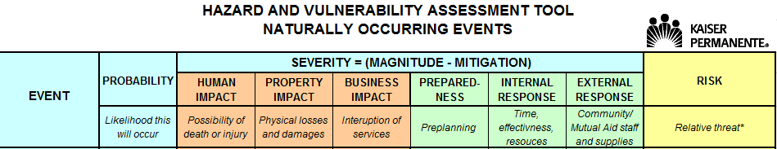
Hazard Vulnerability Analysis (HVA)
Planning Resource Tool - Kaiser Permanente
Probability x Severity* = RISK
* SEVERITY = Magnitude (Impact) – Mitigation (Preparedness + Response)

Slide 11
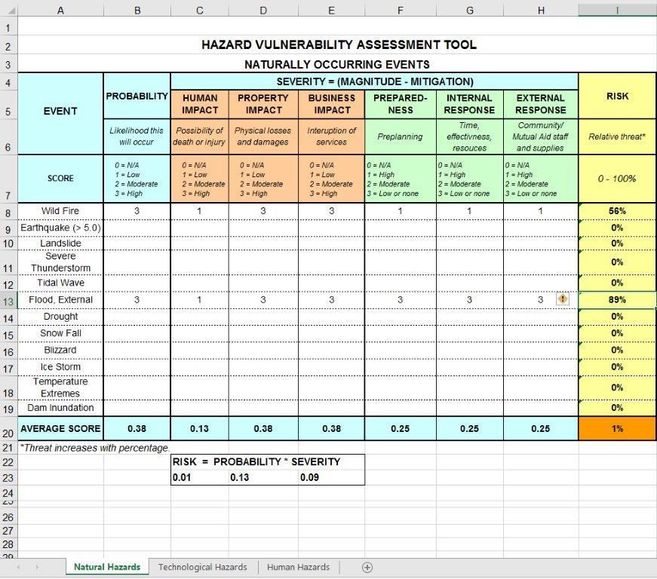
Hazard Vulnerability Analysis (HVA)
Planning Resource Tool - Kaiser Permanente

Slide 12

Hazard Vulnerability Analysis (HVA)
Planning Resource Tool - Kaiser Permanente

Slide 13
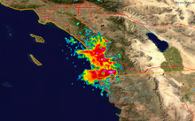
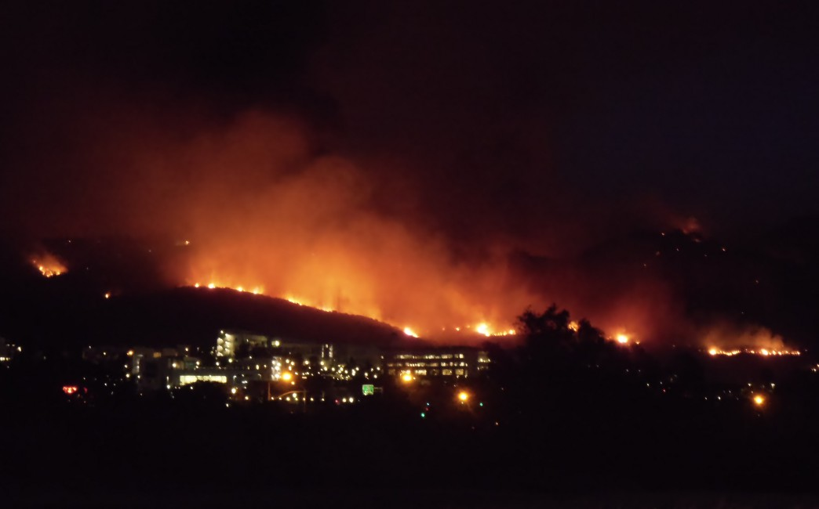
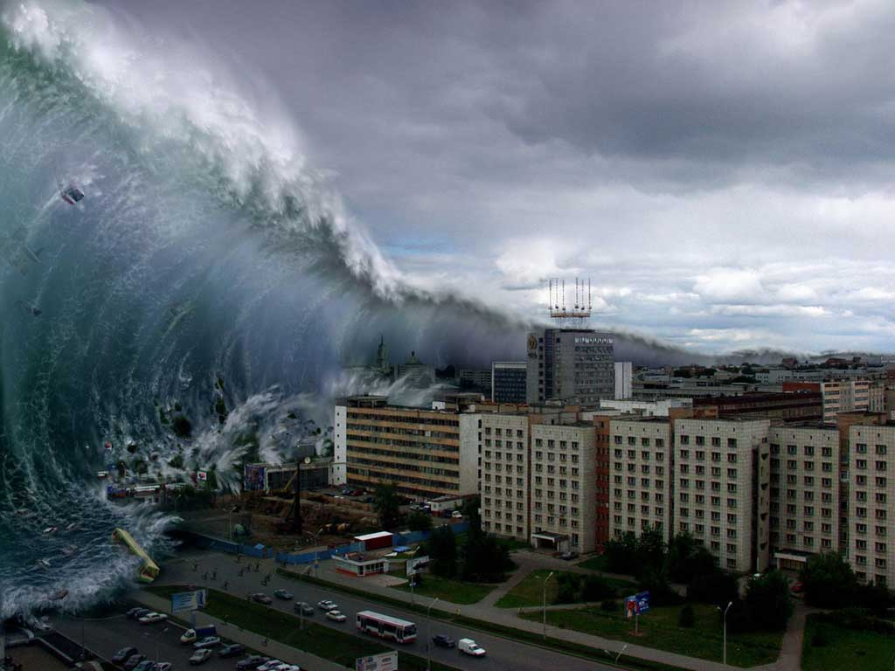
Hazard Vulnerability Analysis (HVA)
Natural Hazards
Wild Fire
Earthquake (> 5.0)
Landslide
Severe Thunderstorm
Tidal Wave
Flood, External
Drought
Snow Fall
Blizzard
Ice Storm
Temperature Extremes
Dam Inundation

Slide 14

Hazard Vulnerability Analysis (HVA)
Technological Hazards
Information Systems Failure (> 4 hrs.)
Communications Failure (> 4 hrs.)
Fire, Internal (major)
Electrical Failure
Generator Failure
Total Elevator Failure
Water Failure
Flood, Internal
Fuel Shortage
Sewer Failure
Natural Gas Failure
Fire Alarm Failure
HVAC Failure
Data Compromise
Denial of Services (computer/network/website)

Slide 15

Hazard Vulnerability Analysis (HVA) human Hazards
Epidemic/Pandemic
Mass Casualty Incident (trauma)
Violent Person
Train Crash (at facility)
Terrorism (CBERN)
Bomb Threat
Civil Disturbance
Hostage Situation
Labor Action

Slide 16
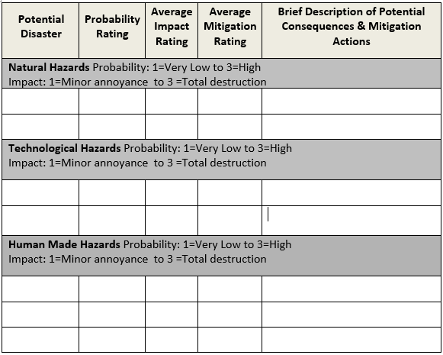
Hazard Vulnerability Analysis (HVA)
Summary
I have the HVA done, now what do I do with all this info?

Slide 17

Hazard Vulnerability Analysis (HVA)
Q&A

Slide 18
Keys to a successful Emergency operations plan (EOP)
Hazard Vulnerability Assessment (HVA)
Policies and Procedures (Annexes, Quick Reaction Checklists)
Emergency Communications Plan (ECP)
Training and Testing

Slide 19
EOP
4 Phases of emergency Management
Preparedness
Response
Recovery
Mitigation

Slide 20
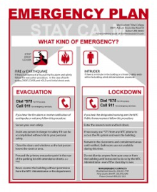
Emergency Operations Plan (EOP)
CMS Requirement: Must develop and maintain an all hazard plan based upon the risks and vulnerabilities raised in the HVA
  Emergency Operations Plan (EOP) and Business Continuity Plan (BCP) that can guide your organization’s response to both medical and non-medical disasters
  Update EOP and BCP annually for each of your FQHC sites
  EOP must include elements such as:
    Incident Command System (ICS) to reflect who is in charge
    Supplies and equipment to support effective disaster response and recovery
    Making provisions for patient tracking and vulnerable populations health needs

Slide 21
EOP checklist Review
Industry Best Practices
Review Annually
Based on CMS Rule dated September 2016
CMS Interpretive Guidance TBD

Slide 22
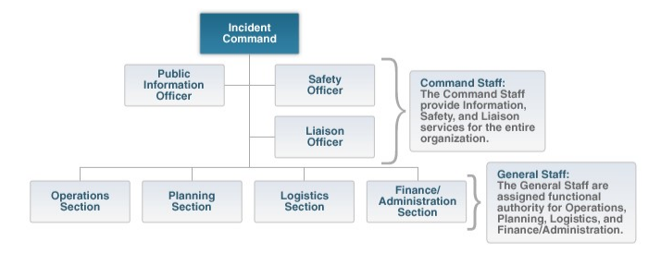
Incident Command System command & General Staff

Slide 23
Incident Command System

Slide 24
Emergency Communications Plan
CMS Requirement: Must have internal and external communications plans & redundant communication systems
Internal: Notify patients, staff, and Board of a disaster impacting the FQHC
External: Notify external stakeholders such as federal, tribal. State, and local agencies
Redundant communications: Have radios, satellite phones, ham radios, etc.

Slide 25

Training and Plan testing
CMS Requirement: FQHCs must conduct and document annual training and test plans with 2 exercises annually
Training: Conduct and document annual training on your emergency preparedness policies and procedures to all staff, volunteers, and Board
Exercises: Must conduct and document two exercises annually of EOP
  One must be a full scale drill that can be a community or facility based exercise
  The other exercise can be your choice can be a functional or tabletop exercise

Slide 26
Member Discussion
What are your biggest take-aways about the CMS requirements?
Which CMS EP Requirements most concern you?
How can we best help you?

Slide 27
Training Debrief and Next Steps
Tell us what you liked about the training?
What could we have done differently?
Project Next Steps
Monthly CMS EP requirement conference calls
June 27th training on exercise design at a health center

Slide 28
Offers of Support
As a member of HCPSC, Connect Consulting Services will offer a free 30 minute phone consultation regarding your CMS compliance needs.
In addition, Connect Consulting Services will offer a 15% discount on our planning, training, and exercise services.
Please contact Norma Springsteen at Norma@ConnectConsulting.biz to schedule a call with us to see how we can help your FQHC

Slide 29
Contact Us!
Jill Webber, MPH, Program Manager
Health Quality Partners – Health Center Partners
7535 Metropolitan Dr., San Diego, CA 92108
direct: 619.542.4324
fax: 619.906.2486
jwebber@hcpsocal.org
www.hqpsocal.org
Nora O’Brien, MPA, CEM, Chief Executive Officer
Connect Consulting Services
701 12th Street, Suite 202, Sacramento, CA 95814
Nora@ConnectConsulting.biz
Office: 916 758-3220 Mobile: 916 806-7361
Twitter: @NoraConnect
www.ConnectConsulting.biz

