Slide 1
Environmental Scan: Opportunities and Challenges from a Regulatory Lens
NACHC Winter Strategy Meeting
January 25, 2017

Slide 2
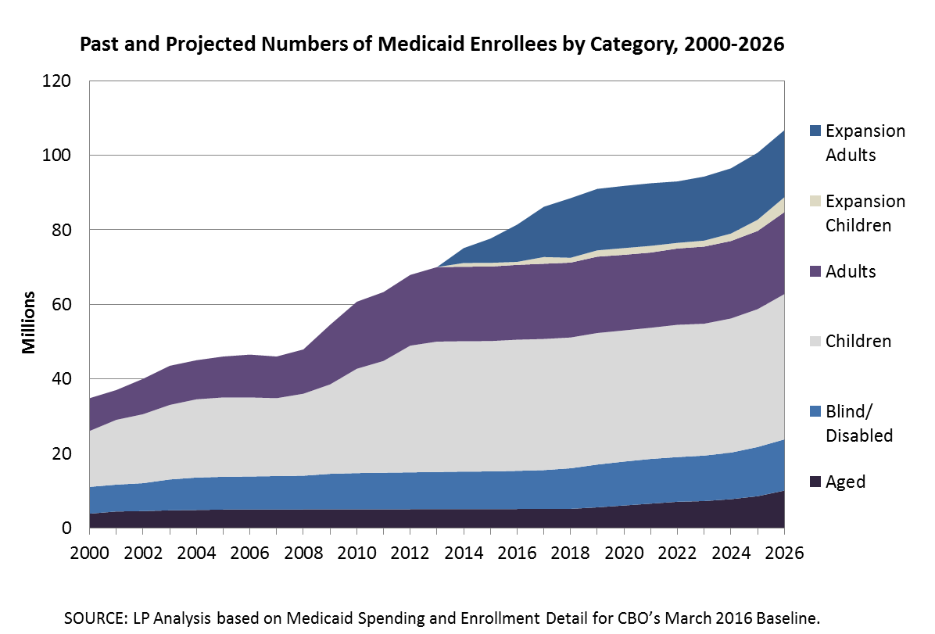
Projected Medicaid Enrollment
~110M Covered Lives in Medicaid by 2026
Note: Enrollment numbers are “total ever enrolled.”

Slide 3
Projected Medicaid Enrollment
~110M Covered Lives in Medicaid by 2026
Health
Care
Reform
Note: Enrollment numbers are “total ever enrolled.”

Slide 4
CMS: Key Signals
$
Decrease Federal Costs
Increase State Flexibility
Reduce Medicaid Enrollment

Slide 5
Previous “Signals" From CMS on 1115 Waivers
Premiums (limited)
Some copays above federal limits
DSRIP
DSHP
Waiving retroactive coverage
Cost sharing below 100% FPL
Lock-out period
Partial expansion to 100% FPL with enhanced FMAP
HSA-like models
Healthy behavior incentives
IMD exclusion
Work requirement
Enrollment caps
Enrollment time limits
Closed formularies
PPS rate
X
X
X
X
X
NA
X
NA

Slide 6
New Administration: New Priorities
Premiums
Some copays above federal limits
DSRIP
DSHP
Waiving retroactive coverage
Cost sharing below 100% FPL
Lock-out period
Partial expansion to 100% FPL with enhanced FMAP
HSA-like models
Healthy behavior incentives
IMD exclusion
Work requirement
Enrollment caps
Enrollment time limits
Closed formularies
PPS rate
?
X
X
?
?
?
?

Slide 7
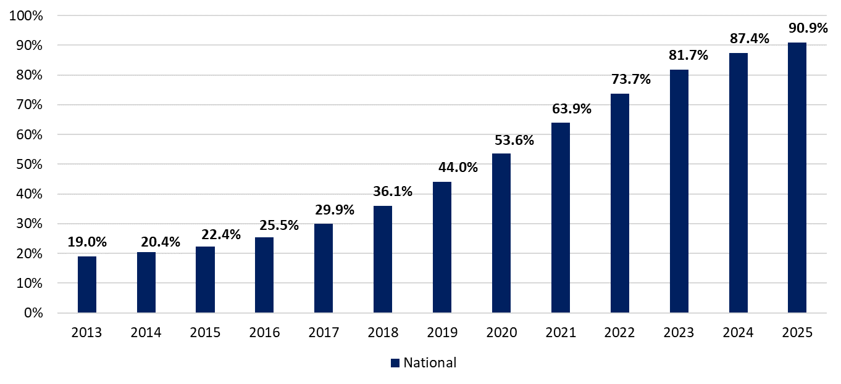
Focus on Value-Based Payments May Slow
Percentage of Total Care Delivered Under Value-Based Payments
Pre-2017
?
Source: Leavitt Partners 2016. All payers.
More state-driven models, but less federal support…

Slide 8
Expected State Actions on Value-Based Payments
States with existing initiatives will continue to develop and refine, with an eye toward CMS signals.
States in the initial design phase may reassess their initiatives based on CMS’ priorities.
States that have pursued more flexible models will continue to promote and provide flexibility to providers.
Decrease Federal Costs
Increase State Flexibility
Reduce Medicaid Enrollment
Decrease Federal Costs

Slide 9
Future of State Medicaid Programs
Increased focus on cost saving initiatives
Increased focus on payment & delivery system reform
1115
Waivers
Reducing benefits and services and eliminating all non-essential costs
Increasing efforts to maximize efficiency and reduce duplicate services
Most states will seek elements of both sides

Slide 10
Opportunities
Opportunities and strategies will be state specific and vary:
Determine where your state falls on the spectrum
Note: States may have different initiatives across the spectrum
States that fall more to the left side of the spectrum:
Promote CHCs’ role as the “true safety net provider”
Look for opportunities within key initiatives (e.g., work requirements, expanding managed care)
States that fall more to the right side of the spectrum:
Promote CHCs’ role as contributing to integration
Look for opportunities within key initiatives (e.g., behavioral health integration, full or targeted expansions)
All states:
Continue to pursue value-based payment opportunities
Areas to Watch
Behavioral Health Integration
Dual Eligible Initiatives
Delivery System and Payment Reform
Long-Term Services and Supports
Social Determinants of Health
Targeted Interventions (high cost individuals)
Prescription Drugs
Medicaid Financing

Slide 11
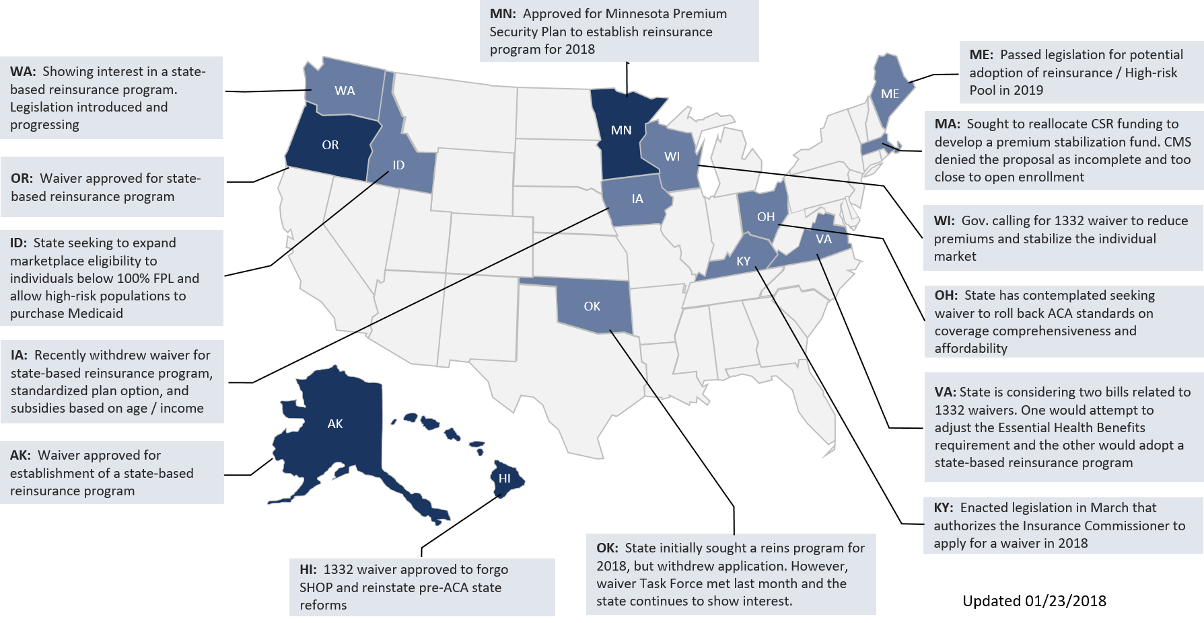
State Interest in 1332 Waivers
Interest in 1332 waivers has grown as states seek urgent policy solutions as federal uncertainty is sustained.

Slide 12
States Can Coordinate 1332 & Medicaid 1115 Waivers
1115 Waivers
Medicaid-focused (0-133% FPL)
Premium assistance for QHPs in the Marketplace (for Medicaid)
Restrictions to beneficiaries’ choice of providers participating in the QHP or ESI network
Payment to providers equal to QHP or ESI market rates
Targeted cost-sharing
Premiums for individuals with incomes between 100-138% FPL
1332 Waivers
Private insurance market-focused
(133% FPL and up)
Marketplace modifications: Ideas on alternative design/use
Policy enhancements: Clarify or adjust ACA policies relative to state-specific market conditions
New coverage programs: Evaluate adoption of commercial programs that target vulnerable populations
Waivers allowed to date
Potential options under “Super Waivers”
Combine Medicaid and premium assistance into a single private marketplace
Modify the premium subsidy calculation for those who move above or below 100% FPL
Treat income the same way across the Marketplace and Medicaid
Modify verification rules to be consistent across Medicaid and commercial market
Implement consistent enrollment effective dates and coverage periods
Align the definition of Native American

Slide 13
States Can Coordinate 1332 & Medicaid 1115 Waivers

Slide 14
Future of Individual Insurance Markets
State customization of current framework
Fundamental redesign of
ACA markets
Individual Market Reforms
Efforts to stabilize current markets, working within the structure of the ACA
Alter benefits, reprioritize subsidies, and eliminate all non-essential costs

Slide 15
Key Actions
Be proactive and collaborative
Understand your state’s pressure points and motivations
Turn pressure points into positives for health centers
Approach with attitude of “how you can help.”
Leverage existing partnerships as well as potential partnerships

Slide 16
Smart on Value
www.leavittpartners.com

