Slide 1
Day at the Capitol Preparation Webinar
April 21, 2026

Slide 2
Webinar Agenda
Welcome & Introductions
DAC Schedule & Speakers
Legislative Priorities
Budget Priorities
Provided Materials
Best Practices & Social Media
Question and Answer

Slide 3
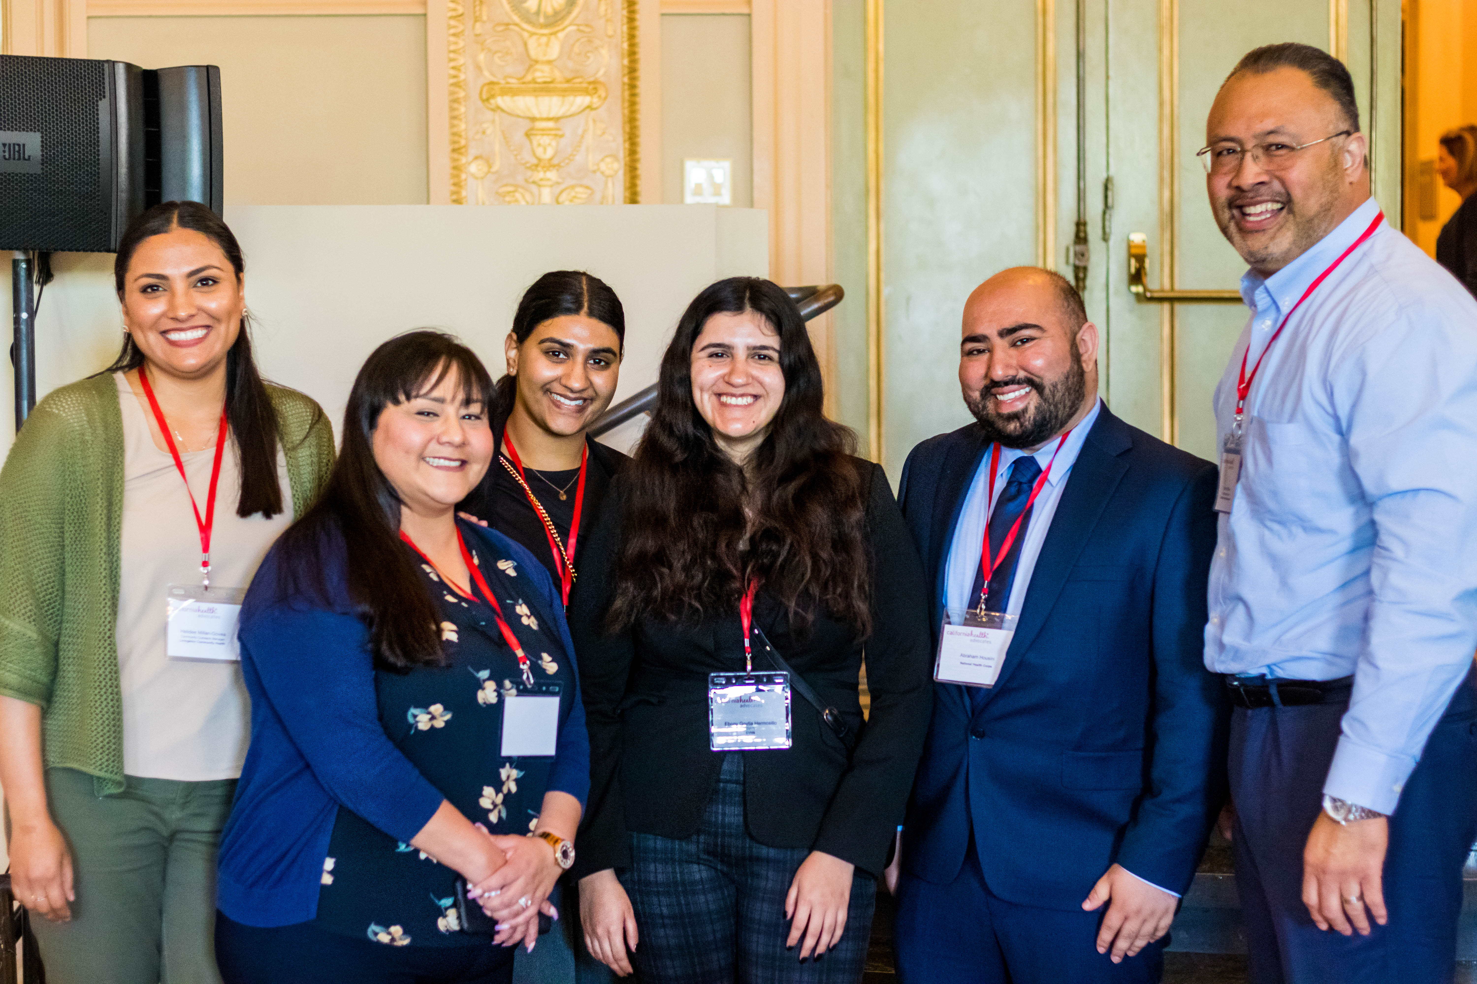
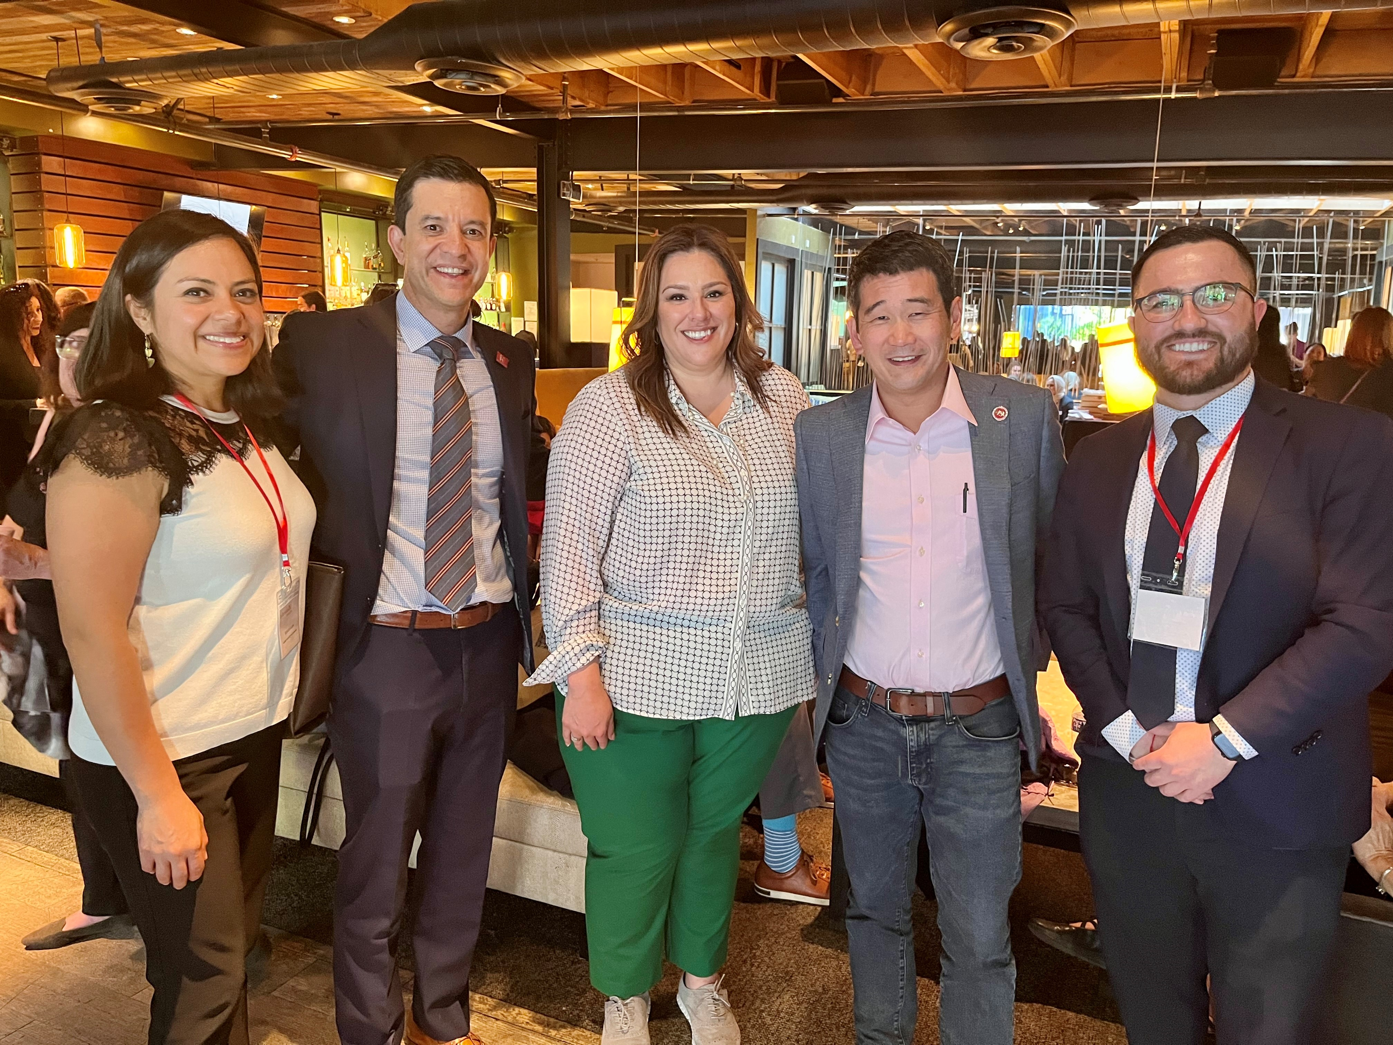
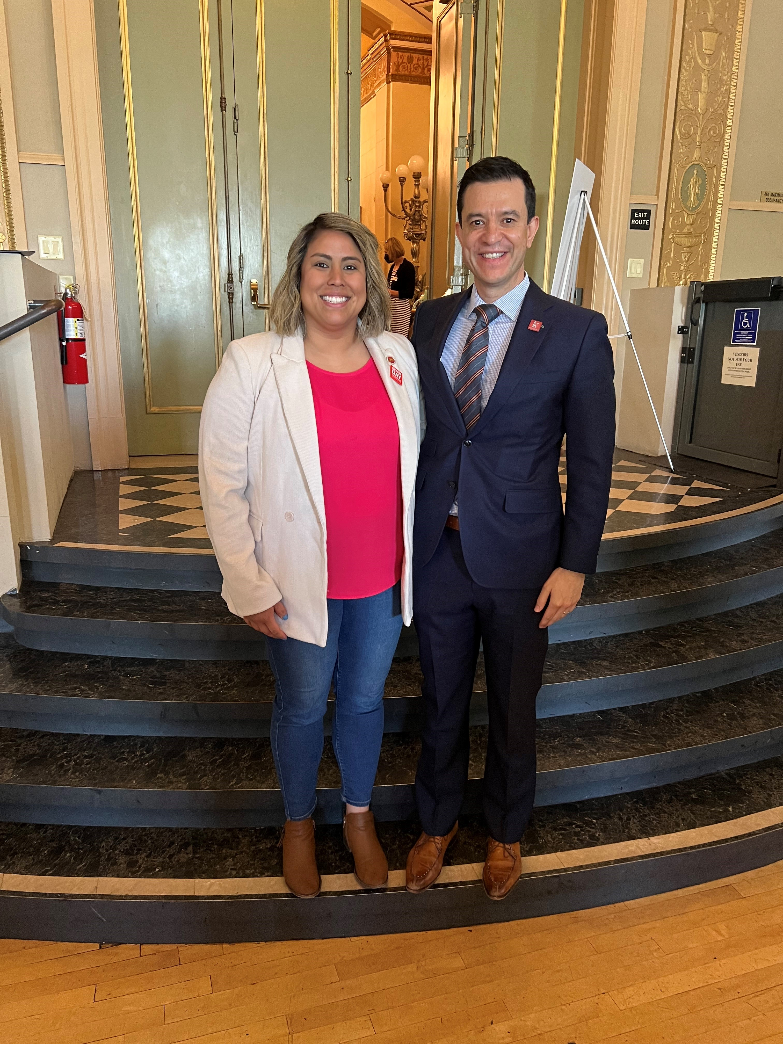
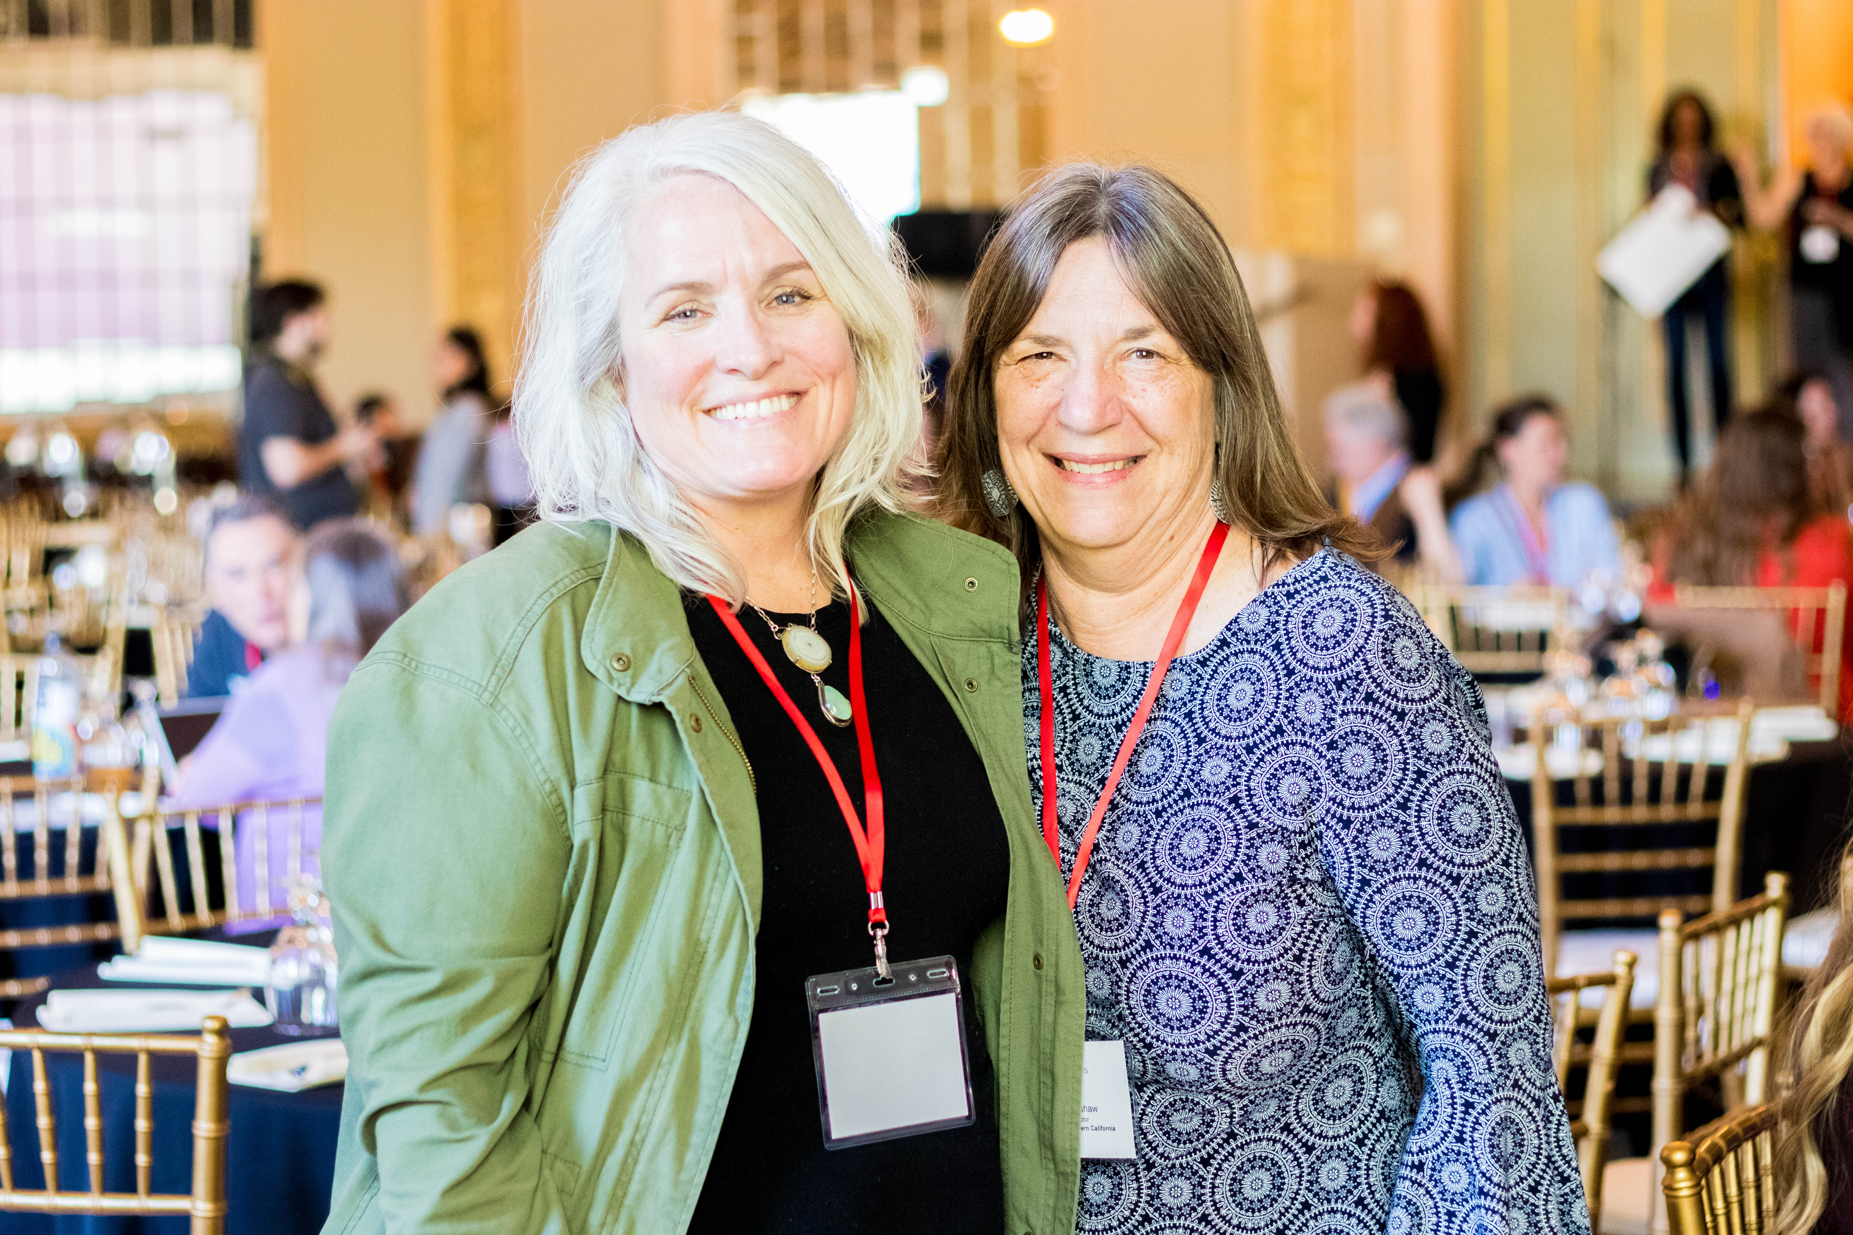
Day at the Capitol
Day at the Capitol is a day of advocacy, storytelling, networking, and uniting in support of community health centers and to help raise awareness about community health center priorities!

Slide 4
Day at the Capitol Agenda
Sheraton Grand Hotel - 1230 J Street, Sacramento
7:30 - 9:00 am Member Check-in & Light Continental Breakfast
8:00 - 8:40 am Welcome Session & Material Review
Welcome: Dennis Cuevas-Romero, Esq., VP of Government Affairs CPCA Advocates
Opening Speaker: Xavier Becerra, Former US HHS Secretary
9:00am - 12:00pm Legislative Visits - Swing Space/10th & O Streets
Educational Session – (9:15 – 10:15 am) and (10:30 am – 11:30 am)
11:30 am – 1:00 pm Lunch Program
Keynote: Francisco J. Silva Esq., President & CEO CPCA Advocates
1:00 – 5:00 pm Legislative Visits - Swing Space/10th & O Streets
4:30 – 6:30 pm CPCA Advocates PAC Reception/Smic’s on K St
**CPCA Advocates PAC Donation required to attend.

Slide 5
DAC Educational Sessions
Educational Session #1
9:15 am – 10:15 am
Storytelling as Strategy: From Provider Story to Political Priority. Every policy issue begins as a story—but not every story becomes a priority. Learn how to frame and deploy narratives that command attention in policy spaces, influence decision-makers, and shape policy outcomes.
Educational Session #2
10:30 am – 11:30 am
Join the California Budget & Policy Center for an overview of the state budget process, and discussion on budget challenges facing California’s healthcare delivery system.

Slide 6
2026 Legislative and
Budget Priorities

Slide 7
Sponsored & Co-sponsored Legislation
Sponsored
AB 1768 (Bryan): Protecting the LA County Safety Net - One-half percent (0.5%) sales tax through Oct. 1, 2031; generates $1B annually
Co-sponsored
AB 2386 (Alvarez): Addressing the Physician Shortage – would create a permanent pathway for the current cohort of physicians practicing as part of the Mexican Physician Program. It would also create a pathway for internationally trained physicians that meet educational and training requirements and authorized to work in the U.S
SB 1179 (Menjivar): Addressing the Physician Shortage – would take the provisions from the Mexican Physicians Program and extend them to physicians from El Salvador that meet educational and training standards to practice at a FQHC under a non-renewable three-year license.
Sponsored Bills*

Slide 8
CHC Legislative Priority: AB 1768
Protecting the LA County Safety Net
AB 1768 (Bryan) Allows LA and Contra Costa Counties to exceed their tax caps. For LA County, this will support a temporary one-half percent (0.5%) sales tax through Oct. 1, 2031; generates $1B annually
Location: Scheduled for hearing in Asm. Rev & Tax on 4/27; if the bill passes Rev&Tax, it will be heard in Asm. Local Gov. Committee.
CHC ASK:
  For Assemblymembers: Support the bill in the two listed committees or when the bill reaches the Assembly floor.
  For Senators: Support the bill when it reaches the Senate.

Slide 9
CHC Legislative Priority: AB 2386
Addressing the Physician Shortage
AB 2386 (Alvarez) would create a permanent pathway for the current cohort of physicians practicing as part of the Mexican Physician Program. It would also create a pathway for internationally trained physicians that meet educational and training requirements and authorized to work in the U.S
Location: Assembly Appropriations Committee
CHC ASK:
  For Assemblymembers – vote for the bill on the Assembly floor
  For Senators – support the bill when it reaches the Senate

Slide 10
CHC Legislative Priority: SB 1179
Addressing the Physician Shortage
SB 1179 (Menjivar) would take the provisions from the Mexican Physicians Program and extend them to physicians from El Salvador that meet educational and training standards to practice at a FQHC under a non-renewable three-year license.
Location: Senate Appropriations Committee
CHC ASK:
  For Senators – support the bill on the Senate floor
  For Assemblymembers – support the bill when it reaches the Assembly

Slide 11
CPCA Advocates Budget Priorities
Restore Full-Scope Medi-Cal for Immigrant Californians & PPS for UIS
Roll back the cuts made in the 2025-26 State Budget Act, including the enrollment freeze, unaffordable monthly premiums, and elimination of dental benefits for undocumented enrollees, to maintain the state’s commitment to health equity.
Specifically, retain full health center payments (PPS) for services provided to patients with unsatisfactory immigration status (UIS) by community health centers and clinics, or at least delay this proposal until Jan 1, 2028.
CHC ASK:
  For Senate: Express appreciation for proposed Jan. 1, 2028, delay.
  For Assemblymembers:
    Sign onto Legislative letter supporting PPS for UIS restoration/delay (or thank them for signing on)
    Align with the Senate’s proposal to delay until Jan. 1, 2028

Slide 12
CPCA Advocates Budget Priorities
Gender-Affirming Care (GAC)
Support the $26M budget ask to secure state funding to protect gender-affirming care (GAC) services for individuals under the age of 19 and those who have lost access to healthcare coverage due to federal policy changes. Funding will:
  Create a state-only billing pathway under Medi-Cal for youth GAC services ($1M); and
  Bolster the capacity of providers to scale up services for patients who have lost access to care due to hospital youth GAC clinic closures ($25M)

Slide 13
CPCA Advocates Budget Priorities
Health Enrollment Navigator Funding
Dedicate state funding to expand a pool of public/private funding to restore funding for the Health Enrollment Navigators Project to support Medi-Cal outreach, enrollment, and renewal efforts given new and significant changes to the Medi-Cal Program.
  Currently $500K has been dedicated by the Centene Foundation ($1M with federal match)
  No state funding is currently dedicated to Health Enrollment Navigators in the upcoming fiscal year

Slide 14
Materials Available
Fact Sheets & Talking Points
  State Budget Priorities
  AB 1768
  AB 2386
  SB 1179
  Comprehensive Talking Points
2025 CHC State Profile

Slide 15
Best Practices, Advocacy & Social Media

Slide 16
Engaging Elected Officials
Get to Know Your Legislators
  Review their biography
  Understand their priorities and what committees they’re on
  Review social media accounts
Meetings
  Coordinate a meeting place and time with your group
  Designate a meeting "facilitator"
  Tell your community health center story
  Elevate patient stories
  Show your passion
  MAKE THE ASK!
  Follow-up with digital informative & identifying information
  Thank legislator/staff and post on social media if you take photo

Slide 17
Social Media Best Practices
Post on the appropriate social media platforms!
Bring awareness to DAC and CHC legislative priorities
Use hashtags: #DAC2026 #ValueCHCs #CHCAdvocacy
Tag @CPCAAdvocates
Tag your legislators
  Their handles might vary on different platforms!
  Use our Social Media Directory that can be found on the CPCA Advocates website!

Slide 18
Photo Opportunities
  Highlight your work by taking photos and sharing them throughout the day!
  State Capitol: Take a photo or selfie in front of the California State Capitol.
  Swing Space: Take a photo or selfie in the Swing Space.
  Legislative Office: Take a photo or selfie in front of your legislator’s office.
  Legislative Visit: If your legislator or staffer agrees, take a photo at the end of your meeting.
  Colleagues/Team: Take a photo or selfie with your colleagues and lobby team.
  RAC/Consortia: Take a photo or selfie with your consortia members.
  CPCA Staff: Take a photo or selfie with a CPCA staff member.
  CPCA CEO: Find and take a photo or selfie with CPCA’s CEO Francisco J. Silva, Esq.
  Educational Session: Take a photo or selfie of you attending the educational sessions.
  Lunch Program: Take a photo or selfie during the Lunch Program.
  Legislative Reception: Take a photo or selfie while at The Mix for the Legislative Reception
  Don’t forget to tag @CPCAAdvocates so we can highlight you!
  Please use hashtags #DAC2026 #ValueCHCs and #CHCAdvocacy

Slide 20
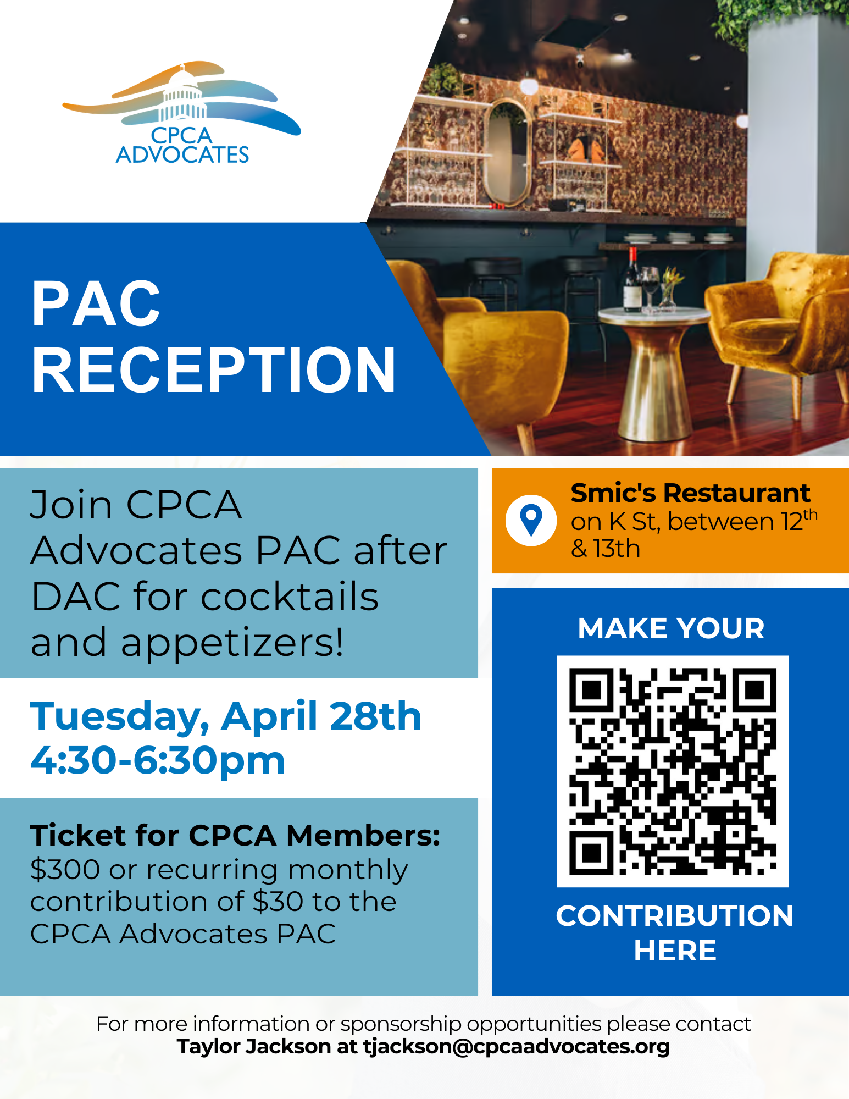

Slide 21
Questions?
Dennis Cuevas-Romero – VP of
Government Affairs Dennis@CPCAadvocates.org
Taylor Jackson – Director of Government
Affairs & Political Engagement
Tjackson@CPCAadvocates.org
Laura Sheckler – Director of Budget Advocacy & Strategic Policy Laura@CPCAadvocates.org
Andrea Amavisca – Deputy Director of Government Affairs
Andrea@CPCAadvocates.org
Anna Marshall – Deputy Director of
Federal Affairs & Policy Anna@CPCAadvocates.org
Kelley Aldrich – Assistant Director of Government Affairs
Kelley@CPCAadvocates.org
Marisa Melendez – Senior Administrative Assistant
Marisa@CPCAadvocates.org

